Slide 1
Digital Customer Experience (DCX) at Capgemini
IIT Bombay, Tech Fest 2017
30th Dec 2017

Slide 2
DCX Team
Pankaj Rathor - Technical Architect
Vipul Raut – Technical Architect
Priyanka Mahajan – Lead Hybrid Developer
Ajay Kandari – Hybrid Developer
Avijit Sarkar – Hybrid Developer

Slide 3
Agenda
Introduction to DCX
Digital Customer Experience
Mobility
Introduction to I&D
Workshop
Mobile App development
Analytics overview
Interactive discussion
Q & A

Slide 4
Digital has radically modified people’s behavior and expectations…
New consumers…
…as well as new employees !
Anywhere, anytime
Easy to use
Efficient
Personalized
Anticipated

Slide 5
Companies need to face customer’s expectations through a deep transformation that will impact their strategy, their organization, their systems…
Anywhere, anytime
The Digital proliferation has radically modified people’s behavior and expectations
Easy to use
Efficient
Personalized
New consumers…
…as well as new employees !
Anticipated
The major question is : how to engage such a wide transformation ?
“
“
Customer experience is the single biggest catalyst for digital transformation
Brian Solis – Altimeter. (September 2015)

Slide 6
… so, what is Customer Experience?
It is also the bridge between customer and business goals
Customer Experience is a combination of the perceptions, emotions, reactions that a customer has while employing different channels to interact with a company’s environment, products or employees.
The outcomes are the actions a consumer takes as a result
Simplicity
Reliability
Customer
Business
Value
Individuals
B2C
B2B
More Sales
Digital Customer Experience
Government
Speed
Increased CLTV
Trust
Sales force efficiency
Corporations
B2B2C
Reduced cost of Sale
Speed to Value
Costs reduction
Success comes by skillfully connecting customer experience to customers’ ever changing needs in a way that delivers value at speed for both business and customer

Slide 7
Capgemini DCX value proposition - Make the connections that make a difference !
Connecting
We partner with our clients to make the right connections across the whole of their enterprise so that they can create experiences that deliver rapid and sustainable value for their customers and their company.
Customers
Clients
Touchpoints
Data Layer
Technology Solutions
!
Because extraordinary connections deliver extraordinary results.
!
Enabling Process Layer
Organizational Layer

Slide 8





The Global DCX Community: about 10,000 passionate people across the Capgemini group!
Europe
4,000
North
America
500
Asia-Pacific
250
Morocco
200
India
4,500+
Latin America
250

Slide 9






















































A snapshot of marquee DCX Clients across the Globe
North America (USA & Canada)
France
UK & Ireland
Benelux
Nordic Countries
China
Latin America
Spain
Italy
Central & Eastern Europe
India
Australia

Slide 10
Capgemini DCX orchestrates five Capabilities with their underpinning Solutions
CREATE A CONTEXTUAL VIEW OF THE CONSUMER AND ITS JOURNEYS WITH THE BRAND
DESIGN AND EXECUTE COMPELLING, ENGAGING EXPERIENCES
Qualitative & Quantitative Research
Ethnography
Journey Mapping
Persona Development
Social media and sentiment Analysis
Segmentation – personalization
Omni-Channel Experience Strategy
Omni-Channel Customer Interaction Design
On and Offline User Experience Design
Digital Content Strategy
Digital Content Development
Campaign Design
DCX
MEASURE, REFINE AND OPTIMIZE
Cross Channel Attribution
KPI development
AB/Multivariate Testing
Smart Processes Monitoring & Optimization
ARCHITECT AND DEPLOY ADAPTIVE TECHNOLOGY SOLUTIONS
Customer Interactions Management
Content & Knowledge Management
Customer Management - Customer and Operations Monitoring
Customer Process Management
Digital commerce
IT Digital Platform
ACTIVATE AND TRANSFORM PEOPLE, GOVERNANCE & ORGANIZATIONS
Organizational Change Management
Digital Operating Model
Digitization Strategy
Process Re-imagination
Maturity Assessments

Slide 11

















DCX India CoE – Practice & Technology Landscape
DCX Practices
Customer & CRM
Commerce
Content & Marketing
Digital Channels
(Mobility, UX & UI)
BPM & Enterprise Integration
Technology Landscape
4 DCX
Focused
Technologies
Leader in Customer Engagement platform
Leader in Digital Commerce
Leader in Content experience and Marketing solutions
Leader in connecting Customer journeys with processes & decision automation

Slide 12
Digital Transformation Management
Reach
Target
Connect
Omni Channel Dx
Mobile - Web
Marketing, Customer & Commerce Management
BPM, Integration & Orchestration
User Experience / Visual Design
Messaging Management
Sales Transformation
Omni-Commerce Transformation
BPM Technology
Domains
Mobility Platforms
Process Automation
Social Media Management
Service Transformation
Digital-Humanized Transformation
Omni Channel Approaches
Reengineering & Dev
Connected Things
Content Management
Loyalty Management
Omni Commerce Enablers
APIs & Services
Content Management
Adobe AEM, Drupal, IBM, Oracle,HTMl5, Sitecore
Social Media Management
Adobe, SAP, Salesforce
Messaging Management
Adobe, SAP, IBM, Salesforce, Oracle Hadoop, Teradata
Sales & Service Transformation
Pega, Odigo, MS, Netsuite,
Salesforce, SAP
Loyalty Management
SAP, Salesforce, Oracle
Technology Stack & Approaches
Omni Commerce Transformation
SAP-Hybris, IBM -WCS, Oracle –ATG , Netsuite
Digital-Humanized Transformation
SAP, IBM, Salesforce
Omni Commerce Enablers
Adobe, Opentext, SAP, Oracle
BPM
Oracle, Pega, Mulesoft, Microsoft, IBM
UX/ Visual Design
Digital Journey Definition - Design Thinking -
Rapid UX - Responsive Experience
Mobility
iOS,Android, Windows, HTML5,
SAP SMP, FIORI , IBM Mobile First ,
Bluemix, Kony, Airwatch
Web UI
HTML5 , CSS3, Angular,
Knockout, Backbone

Slide 13
OmniChannel Digital Experience – The Vision
Crafting Context Aware Digital Experiences
Standardized Experience
Experience Design – User Worflows first
Converged Web, Mobile, Wearable experience
Mobiity+Wearable+IOT
The Web
The User Experience
The Any Channel
Full Stack Problem
Solving
AnyWhere,AnyWare,
AnyWear
The OmniChannel
WebDev
The Digital Craft
Digital ways
Reference channel implementation for digital stacks 3C+B
Innovation Friendly Experience design
Create next generation Mobile first full stack digital transformation recipes. Extend solutions to take advantage of all possibilities of any points of engagement
Create WebCentric Points of engagement acceleration. Create the next generation adaptive theme based approaches for usability
Create the next generation experience that disrupts traditional approaches yet create tangible delightful transformations
Industry Friendly
Adapt
Enrich
Disrupt

Slide 14




Capgemini DCX View on Innovations impacting CX Consumer adoption in a prolific and fast changing market
Mobility should be the “alpha” and “omega” of customer experience
Far beyond adapting to smart phones and mobility situations, it requires …
… considering all mobility devices, including “wearables”, as the primary way of interacting, the umbilical cord between brand, consumers and their communities
Mobility Devices
M-CRM
Progressive Web Apps
#Rich Push Notifications
#In App Messaging
#Geo-fencing
“A Progressive Web App uses modern web capabilities to deliver an app-like user experience.”
#Wearables UX/UI
#Retargeting
#Enrollment
#A/B testing

Slide 15
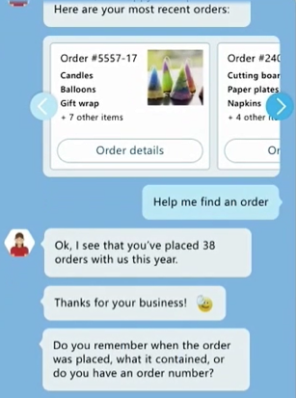
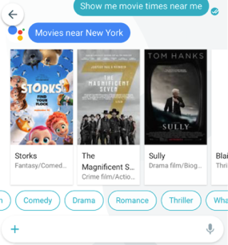
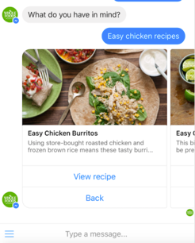

Capgemini DCX View on Innovations impacting CX New Digital enablers for effortless, fluid, personalised and situational consumer experiences
The interfaces for customer interactions become simpler and conversational
Conversational interfaces significantly reduce the need for intermediate supports (such as keyboards) or complex user interfaces (such as mobile apps).
Messaging or Voice based conversations are emerging as new brand front-ends for use cases such as customer service, concierge or advisors, with the right balance between human and robots.
Google Allo
Microsoft Bot Framework
Facebook Messenger
Amazon Echo
Odigo Concierge
Conversational front ends becomes powered with Cognitive technologies

Slide 16
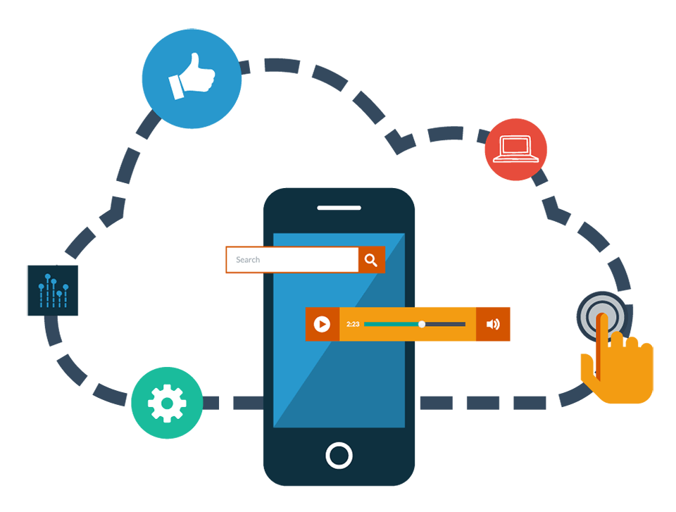
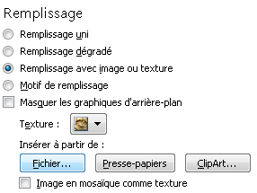
DCX Mobility
Pour modifier l’image d'arrière-plan :
Faites un clic droit et cliquez sur Mise en forme de l’arrière-plan
Dans la fenêtre Remplissage, choisissez Remplissage avec image ou texture puis cliquez sur Insérer à partir de : Fichier
Sélectionnez votre image puis cliquez sur Fermer

Slide 17
Mobility Capability Summary
Leader in Forrester Enterprise / IDC Mobile App Service Providers
Deep technology skills and breadth of end to end service
Significant library of prebuilt IP for enterprise mobile apps, and breath of CX and agency skills
Why Capgemini?
Mobile Factory
One of the worlds largest enterprise Mobility integrators
4000 + Global mobility resources
Mobility COE resource pool of 600 + Mobility Developers
Centers in Mumbai, Bangalore and Pune
Proven Industrialised (Mobile App Factory) Approach
End to End solution: Build, Run (Support), Infrastructure
Cost optimisation & scalability by Rightshoring®
Extensive partnership and alliance ecosystem
Enterprise partner for the Build & Run: Capacity based, Fixed price, Menu Card based
Flexible resource pool with specialised competencies
Uses an industrialised and KPI based delivery process
Deep repository of
Proven Mobility modules & re-usable components
Best Practices, templates and checklists
Services Spread
Certifications & Technical Competencies
Android/ iOS Appitectures, Hybrid Cordova, Xamarin, Kony, SAP Mobile (Fiori/ UI5, Syclo/ Agentry), IBM Worklight/ Bluemix, Windows, Mobile Testing, Predix Mobile, Scrum Certified
Strategy
Experience
& Design
Development
Testing
Security
Managed Mobility
Sectors
Key Solutions/ Accelerators
Pre-built apps – mWorkF, mPOD, Mobile Order Status, Sales Order On the Move, Customer Contacts, PO Approval, Purchase Requisition Approval, Pre-service Inspection, Service Processing, Sales Deal, Quality Inspection & Mobile Metering, Private Mobile Cloud

Slide 18
Mobility has a significant impact on your business
Get bigger share of customer spend
Supercharge customer engagement
Increase your revenues
1
Enhance Organizational effectiveness
Improve workforce productivity
Efficient Enterprise
2
Rewrite the rules of the game
Bring in business transformation
Venture into newer areas
3
Notes:
Customer interactions increasingly depend on software and, by association, user experience (UX). This makes UX a key concern for customer experience professionals
The primary function of UX is the development of an architecture that creates a delightful, emotional, and sensory experience. This is why it’s vital to customer experiences and engagement.
Successful UX evokes engagement or purpose, affects sentiment, and influences behavior
Robust UX is multi-disciplinary and combines elements of product design, service design, and innovation
Today, no company is too big to fail or too small to succeed. Simply knowing your customer is one thing. But, understanding how they make decisions and participating in that process influences behavior while building meaningful relationships.
The lines between business strategy and UX is increasingly blurry. If the user experience doesn't work, companies won't succeed - IBM

Slide 19
Technology trends in Mobility Industry
Faster Development
Multiplatform/Multiarchitecture Application Development Tools
HTML5
Focus on native apps is decreasing with rise in the development of hybrid apps based on HTML5
User
Experience
Advanced Mobile User Experience Design
Location
based services
More businesses and app developers adopting these technologies to offer right information at right place based on the consumer location
Wearable
Focus to move from smart phones to wearable for enterprise applications
App Security
Security remains a big challenge on mobile devices
Enterprise
Apps
Growing opportunity for development and management of enterprise applications
Cloud Technology
With the rise in the usage of multiple mobile devices and wearable, focus is on the ability to integrate and sync apps on multiple devices
Enterprise Mobility Management
Mobile device management, mobile application management, application wrapping and containerization, and some elements of enterprise file synchronization and sharing
Notes:
http://www.gartner.com/newsroom/id/2669915- Gartner Identifies Top 10 Mobile Technologies and Capabilities for 2015 and 2016
https://www.capgemini.com/blog/capping-it-off/2015/12/key-mobility-trends-for-2016

Slide 20







...with a strong mobile technology competence...
Mobile Global Workforce
Skill distribution of developers
4000+ strong team
iOS
Android
HTML5/Cordova
Microsoft
SAP Mobile
IBM
Others
Global F&B Co.
Global CPG Co.
USA healthcare Co.
Pharma Co.
Shoe retailer
European retailer
Medical Device mfg
European retailer
Swedish Engineering Co.
Media Co.
Indian Conglomerate
Medial device manufacturing
Insurance Co.
Auto Manufacturing
Logistic provider
Pharma Co.
Italian Bank
Supermarket Chain
Leading insurance provider
Xamarin
City of Oslo
Council for the Judiciary in Netherlands
Windows
Global bank
Canadian Insurance
DONG
Enexis
UK retailer
American Travel stops and country stores
Global decorative paints company
IBM MobileFirst
Large Brazilian Bank
Swedish Manufacturer
European Banking Group
Kony
Restaurant Chain
German pharma
Mobile Testing
Global Insurance
American bank

Slide 21
Approach to Developing Mobile Apps
Shaping the demand pipeline
Mobility vision and architectural leadership
Managing the delivery of portfolio
IT Ecosystem Readiness Assessment
Mobility Road map Definition
Delivery Engagement Model per program
Rapid Application Development Approach
Understanding and Assessing the common development and IT ecosystems including client’s core solution delivery methodology
Application Requirement Gathering across demand sources
Rightshore execution models
Agile Development Process Model
Roles & Responsibility
Governance team
Architecture team
Execution Core team (Application life cycle management)
Execution Development & Test Team
Application Factory
Demand prioritization and Blueprinting
Collaboration model with all stake holders
Assessing the need of additional systems , processes and methodologies to integrate mobility
Innovation Services to enrich use cases ( Digital innovation themes – Cross channel , Context , Presence etc )
Cap Gemini Mobile Centre of Excellence Support
Quick Pilots
Notes:
Overall scope put in alignment to the key 3 objectives of NG
-Shaping the demand pipeline of mobile work across all UK business units by working with the business and the Business Relations Management teams.
-Providing Mobility vision and architectural leadership, reviewing emerging digital technology trends and developing new mobile competencies.
-Managing the delivery of a portfolio of mobile projects, ensuring that they are set up to succeed and deliver the desired business outcomes
We will assess the IT ecosystem , the standards and guidelines for problem solving initially
We will have a Use case mining phase where we do workshops with Lines of Business , Create Blueprinting , Integrate Digital innovations, Proof by quick Pilots
We will have a Per Program Engagement model definition, If common LOBs we will have unified models. This will also establish the NG mobility COE team and fix the key themes of future focus . This team will have direct integrating with key stake holders at NG and other Tiers to have a collaborative working model
We will follow the Agile scrum model based on the sprint duration determined at planning . We we have a reuse friendly day one approach to focus on enabling assets, methodologies, frameworks, accelerators collated and stored in a reuse friendly manner . There will be Devops frameworks that will materialize this based on the visibility of the scope. We will have a core governance model established with NG & CG based on the Roles and responsibilities that will be standardized across programs.

Slide 22





Mobile Application Development Approach
Considerations for technical solution
Development of Mobile Applications
Mobile Application Design Choices
Native Apps
Cross Platform/
Hybrid
Mobile Web
HTML5/Angular JS/CSS3
Mobility Application Enabling Approaches – Middleware
Mobility Application Development Platform/Framework
Mobility Middleware/ Gateway/ Sync Framework
Mobile Backend As A Service ( MBAAS)
Mobile application Integration Schemes
Mobile Friendly Integrations
Mobile friendly service exposure
Web standards REST/JSON/oDATA protocol compliance
Differential Data Interfaces for optimized mobile data fetches
Federated single sign on authentication schemes

Slide 23
Mobile Application Development Options
Development of Mobile Applications
Native Apps
Cross Platform / Hybrid
Mobile Web / HTML5
Excellent User Experience
Platform dependent
Certify, Distribute and Upgrade
Low code reusability
Fully access to on device capabilities
Notifications
Local storage
Medium to high TCO
Very good to excellent User Experience
Platform specific hooks
Certify, Distribute
Compatibility issues
Can operate offline
Inconsistent runtime environment
Single solution to maintain
Notifications
Local Storage
Low to Medium TCO
Very good User Experience
Device/Platform agnostic
No certification, distribution (Marketplace)
Network dependency
Navigation latency
Wide range of devices
Notifications
Restricted storage
Lower TCO
Notes:
ITi

Slide 24


















Capgemini Mobile Testing Capability Overview
Solutions Offered
End-to-end Mobile Testing services catalogue spanning leading Mobility platforms and Mobile App types (Native, Web & Hybrid)
Functional Testing: Performed by skilled mobility testers to ensure mobile robust end-user experience
Compatibility Testing: To ensure excellent coverage across the fragmented Mobility landscape
Usability Testing: User experience and UI
Compliance Testing: Compliance Testing on HIG Guidelines and W3C compliance
Device/Network Testing: Testing the Application on device and Network specific conditions
Test Automation: Key solution for short time-to-market situations and to enable excellent coverage across devices.
Performance Testing: Meet challenging end user expectations for app performance across n/w types
Security Testing: For mobile apps, free from vulnerabilities and protected against exploits.
Localization testing: Multi language testing
Infrastructure & Tools
Skills & Accelerators
Mobile Lab
Alliances and Partnership
with leading Tool Vendors
350+ Mobile Testing experts across the globe
200+ Mobile Testing experts across RightShore centers in India
Centralized Mobile CoE supporting Delivery to Sales
Assets
Non Functional, Device Specific Test Suite
cMAF automation framework
Wi-Fi and cellular connectivity( 2G / 3G/4G)
100+ Real devices for Android, iOS, Windows
Emulators / Simulators

Slide 25
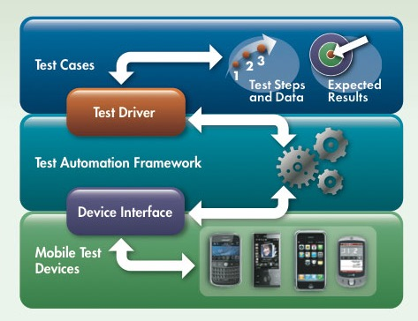





Mobile Automation Approach
Mobile Automation testing focus on
To improve Functional and Regression testing
To provide better coverage on Multi devices /Platform/ browser
To provide better User Interface Testing
To support Agile way of mobile development - Continuous integration and Continuous Testing
Coverage
Open Source Tools
Licensed Tools
Approach
Cloud Devices
Coverage: Testing over an array of device/OS/Browser combination
Unattended script execution and report generation
Improves overall product quality
Saves time and cost
Experience in Automation tools:
See Test
UFT
Perfecto Mobile
Jamo Solutions
Note: The tool will be selected later based on detailed analysis .
Key Benefits

Slide 26
We address every aspect of Mobile App Support
Application Maintenance
QA Services
App Support and Release
App Portfolio Management
App compatibility
Update app to maintain compatibility with new versions of OS/SDK
Add support for new device types (phone/tablet) and screen sizes
Technology Refresh
Take advantage of emerging technology capabilities (e.g. new HTML5 capabilities)
Application Hardening
Monitor security threats
Update application and data against existing and emerging security threats
Application Enhancements
Develop new application functionality to meet changing business requirements
Defect & Bug fixes
Update app code to fix issues affecting the functioning of the app
Application Verification & Validation
Testing to ensure that the changes meets the business requirements
Usage of manual and automated testing methods
App Store Certification
Pre-validation of app to determine compliance to app store policies
Regression Testing
Ensure that changes do not break existing functionality
Performance Testing
Verify that the app user experience is acceptable under varying conditions
Testing on Devices / Simulators
Test app against various devices to simulate real world usage
Issue Management
Troubleshoot user issues with app functioning and provide resolution
App store Deployment
Deploying app to public app stores
Deploying app to enterprise app stores
Management of app rollout
Service Desk
Channel for users to get support for their issues
Email/Telephone/Webchat options
Technology Change Management
Awareness of technology trends
Preparing for new OS versions
Migration Planning to newer technologies
New devices/platforms to be supported
Mobile app architectures
Application Retirement planning
Stop support of old devices / OS
Phase out of app from production environment
Release Planning
Alignment to organization IT release calendar

Slide 27
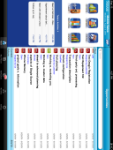
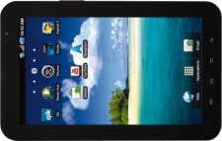



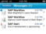
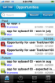


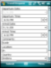
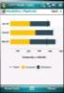





Managed Mobility Service Offering
Provision Capabilities
Production Capabilities
Self-service portal for device enrolment
Over-the-air device configuration (security policies, Wi-Fi access, VPN, certificate authentication, e-mail, data encryption, restricted access to 3rd party apps)
Provisioning of (pre-configured) business apps based on the user’s business role
Maintenance of device configurations and security policies
Mobile App Management
Asset management
Mobile software management (e.g. provisioning of new apps, de-provisioning of retired apps, firmware & software updates)
Security & Compliance Monitoring & Alerting
Back-up / Restore
Analytics & Reporting
Device de-provisioning, including remote lock, remote wipe, selective wipe, disabling access to corporate network and apps
Mobile App Management
Provision
Production
Decommission
Capgemini Mobile Secure offering combines our enterprise mobility consulting, application development, and systems integration expertise with AirWatch’s Mobile Device Management (MDM) and Mobile Application Management (MAM) expertise
Notes:
One Stop – non Stop Service

Slide 28
Questions???

